Slide 1


Project ODKG Open Data and Knowledge graph
Group 5
Aïcha CHERIDI, Alexandre MOREL, Adrien SIMARD

Slide 2
Project Presentation
01
Data preprocessing
02
05
RDF Generation
Ontology
Materials
03
06
Sparql queries
Reconciliation
Application
07
04
Validation
08
09
Lesson Learned

Slide 3
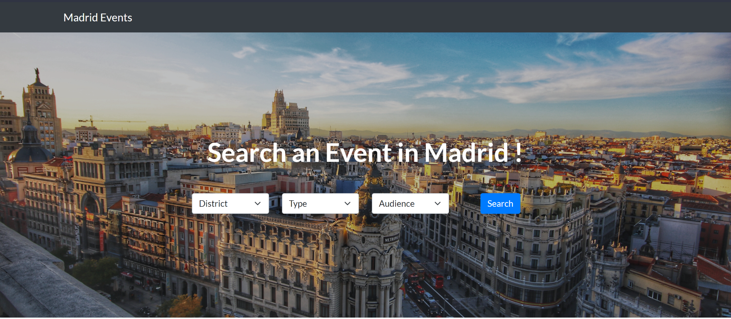
Project Presentation
01
The app will allow the users to find interesting madrid city events based on some criteria like district and targeted audience.
The dataset is about activities of different types that are going to be held or that are being held.
https://datos.madrid.es/portal/site/egob/menuitem.c05c1f754a33a9fbe4b2e4b284f1a5a0/?vgnextoid=57be24206a91b510VgnVCM2000001f4a900aRCRD&vgnextchannel=374512b9ace9f310VgnVCM100000171f5a0aRCRD&vgnextfmt=default
datos.madrid.es
Smart city domain
Project license: CC BY-SA 4.0
Free to share and adapt under the terms of attribution and shareAlike.
Notes:
4 first slides = 1 minutes

Slide 4
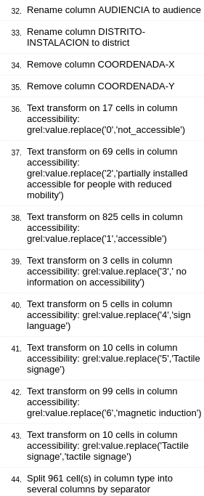
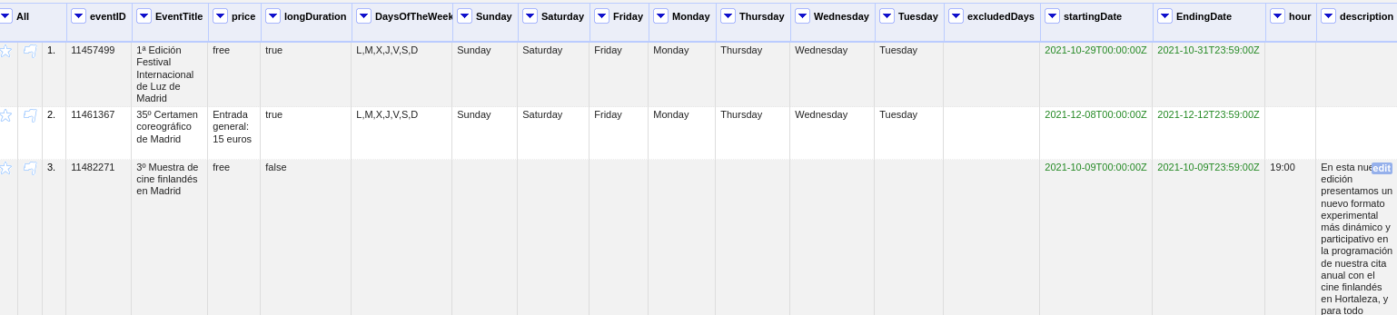
Data preprocessing
02
Delete some columns
Rename columns
Merge the address (join of columns street, number, neighborhood)
Coherence of values
Notes:
4 first slides = 1 minutes

Slide 5
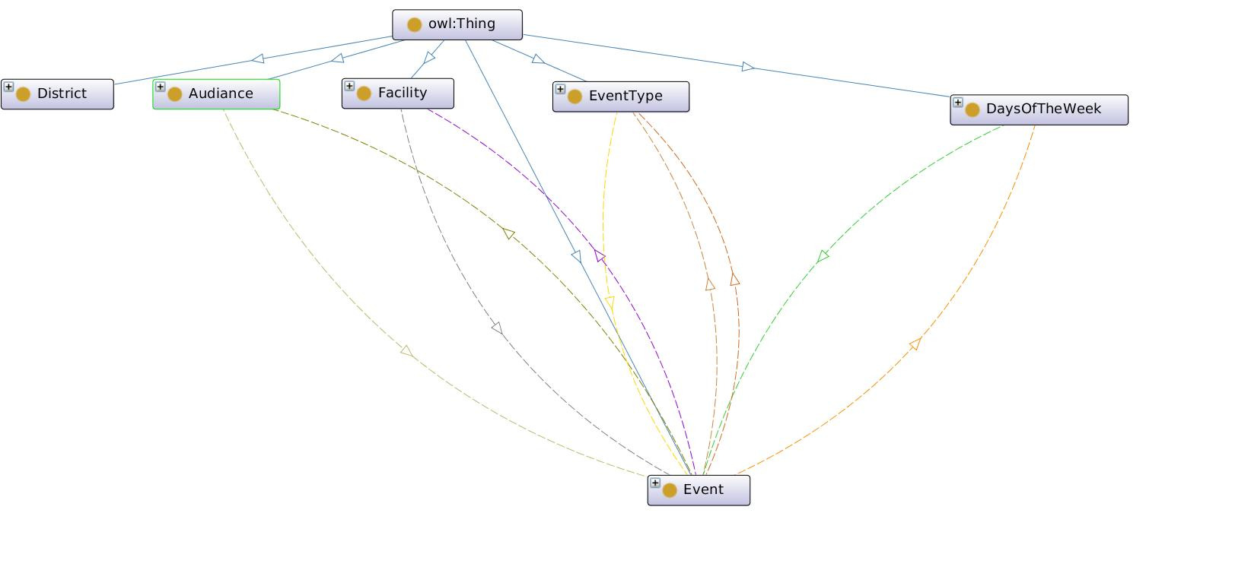
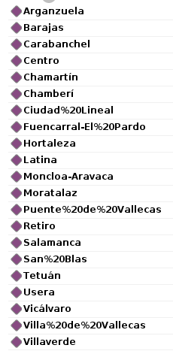
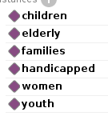
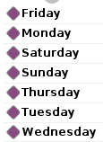
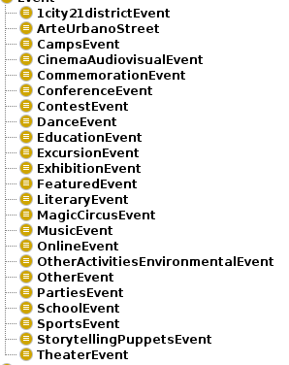
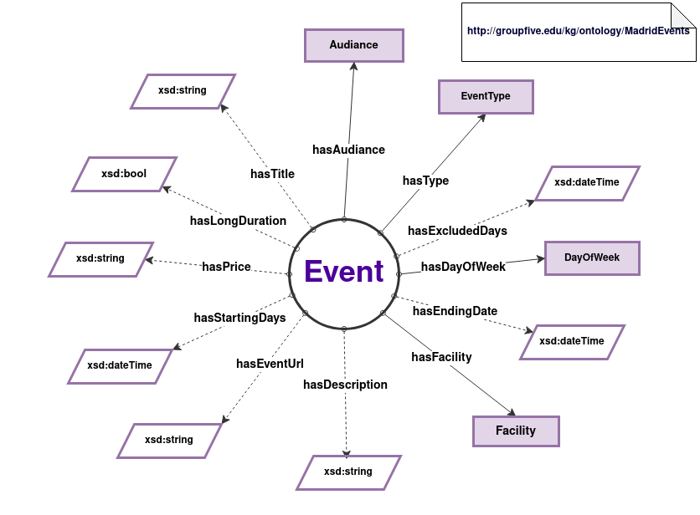
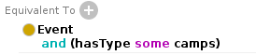
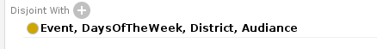
Ontology
03
Ontology URI: “http://groupfive.edu/kg/ontology/MadridEvents#hasAudiance”
Resource URI : "http://groupfive.edu/kg/resources/event/{EVENTID}"
Notes:
4 first slides = 1 minutes

Slide 6
Reconciliation
04
We reconcile our data with the district data of wikidata.
We tried with other columns of our dataset (Facilities, Address) but it was impossible. Just few data and line could be reconcile.
Wikidata doesn’t match the full expression.

Slide 7
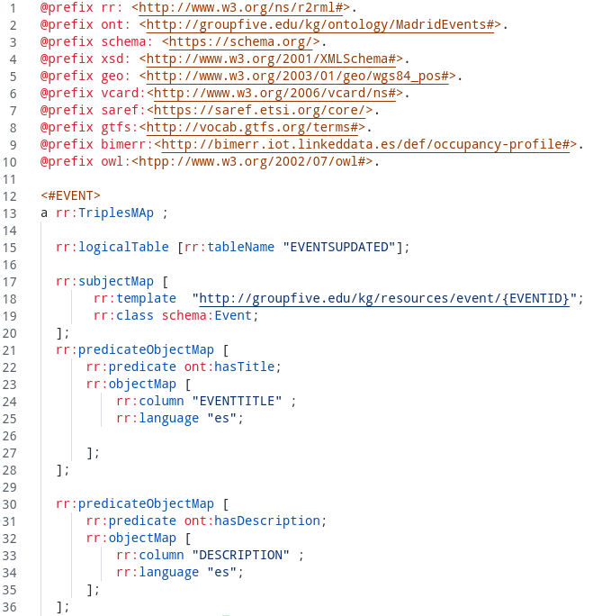
RDF Generation
05
The RDF generation steps:
Creating the mapping csv-rdf using R2RML
Converting the csv to an RDF
Notes:
4 first slides = 1 minutes

Slide 8
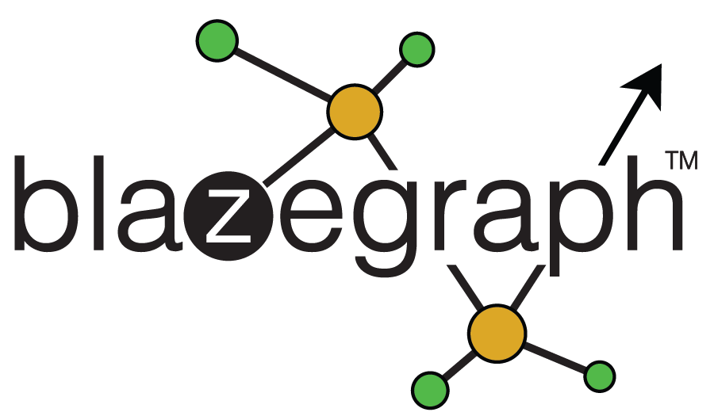
Sparql Queries
06
We used Blazegraph to publish our linked data and to make SPARQL queries.
Our queries adapt to the search criteria selected by the user.
The value of the selected attribute is replaced in the query when searching.

Slide 9

Application
07

Slide 10
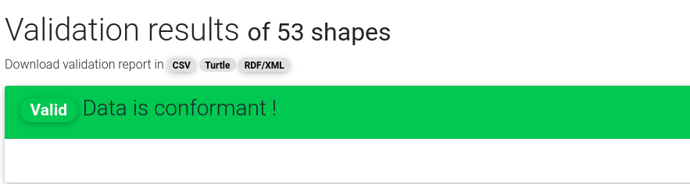
Validation
08
@prefix : <http://groupfive.edu/kg/ontology/MadridEvents#> .
@prefix afn: <http://jena.apache.org/ARQ/function#> .
@prefix dash: <http://datashapes.org/dash#> .
@prefix graphql: <http://datashapes.org/graphql#> .
@prefix owl: <http://www.w3.org/2002/07/owl#> .
@prefix rdf: <http://www.w3.org/1999/02/22-rdf-syntax-ns#> .
@prefix rdfs: <http://www.w3.org/2000/01/rdf-schema#> .
@prefix sh: <http://www.w3.org/ns/shacl#> .
@prefix swa: <http://topbraid.org/swa#> .
@prefix tosh: <http://topbraid.org/tosh#> .
@prefix xsd: <http://www.w3.org/2001/XMLSchema#> .
[ rdf:type sh:ValidationReport ;
sh:conforms true
] .
Notes:
4 first slides = 1 minutes

Slide 11
Lesson learned
09
Lesson learned during this project :
Data reconciliation is more convenient to be executed during the early stages probably just after data preparation.
Ontology is the trickiest part reusing existing ones it far more efficient, but unfortunately not many sources to find complete ontologies.
Create a simple ontology in the beginning and then refine it, this approach makes debugging the reasoner much easier.
Knowledge graph validation before building the application.
Notes:
4 first slides = 1 minutes

Slide 12
Thank you
Any questions ?

